Slide 1


Effective educational strategies of resilient schools
Institute of Education
National Research University
Higher School of Economics
Moscow, Russian Federation

Slide 2

Institute of Education
Conceptual framework
School effectiveness research (Mortimore P., 1988, Hopkins D. 2001, Hargreaves, A., and A. Harris. 2001)
Resilience theory (Hart and Gagnon, 2014; Ungar, M., 2010; Masten A., 2001; Rutter, M., 1999)

Slide 3
Institute of Education
What is a resilience
Hart and Gagnon (2014) “Resilience is overcoming adversity, whilst also potentially tinkering with, or even dramatically transforming (aspects of) that adversity”.
PISA: Resilient students come from disadvantaged backgrounds yet exhibit high levels of school success. (OECD, 2011).

Slide 4
Institute of Education
Research questions
What are the factors determining the possibility of schools, working in challenging social conditions, to demonstrate high academic achievements?
Our research is focused on:
the attitudes of all participants in the educational process regarding academic expectations
the pedagogical strategies for different groups of students in terms of academic achievements
the pedagogical culture of schools.

Slide 5
Institute of Education
Data and methods
«Monitoring of educational markets and organizations» (survey (1273 schools), focus groups and semi-structured interviews (3 schools, two regions) https://memo.hse.ru/en
Contextualisation model
Qualitative research: Qualitative Analysis Software for Content Research - ATLAS.ti

Slide 6
Institute of Education
Contextualization of educational outcomes
To determine the extent of adversity of schools and to estimate school achievements with respect to context factors a contextualisation model was used.
Index of Social Advantage (ISA) =
70 + 30%*« Share of children from families where one or both parents have higher education» - 30%*« Share of children from families where one or both parents are unemployed»- 40%*«Share of children with deviant behaviour»

Slide 7
Institute of Education
Resilient schools: academic achievements
Average score in math exam
Average score in Russian language exam
The average number of students who scored math exam on less than 30 points
Low ISA but high results
(resilient)
High ISA but low results
(failing)
High ISA and high results

Slide 8
Institute of Education
Expectations about schools
List of expectations:
 | Students | Parents | Teachers | Principal
Get high-quality knowledge of school subjects | ✓ | ✓ | ✓ | ✓
Provide quality and interesting teaching | ✓ | ✓ | ✓ | ✓
Produce uniform requirements and objectively assess progress | ✓ | ✓ | ✓ | ✓
To carry out the proper orientation for further selection of educational and / or professional path |  |  | ✓ | ✓
Create a motivating environment for maximum realization of interests and talents |  |  |  | ✓
Teach students to think independently both in the subject content and in life situations |  |  |  | ✓

Slide 9
Institute of Education
Expectations about students
List of expectations:
 | Students | Parents | Teachers | Principal
Learn the subjects | ✓ | ✓ | ✓ | ✓
Acquire important and useful knowledge for life in general | ✓ |  |  | ✓
Finish high school and enter the university | ✓ | ✓ | ✓ | ✓
Finish secondary school and enter a vocational school | ✓ | ✓ | ✓ | ✓
Learn to think and to define themselves |  |  |  | ✓
Choose a profession consciously |  | ✓ | ✓ | ✓
Acquire socialization skills |  |  |  | ✓

Slide 10
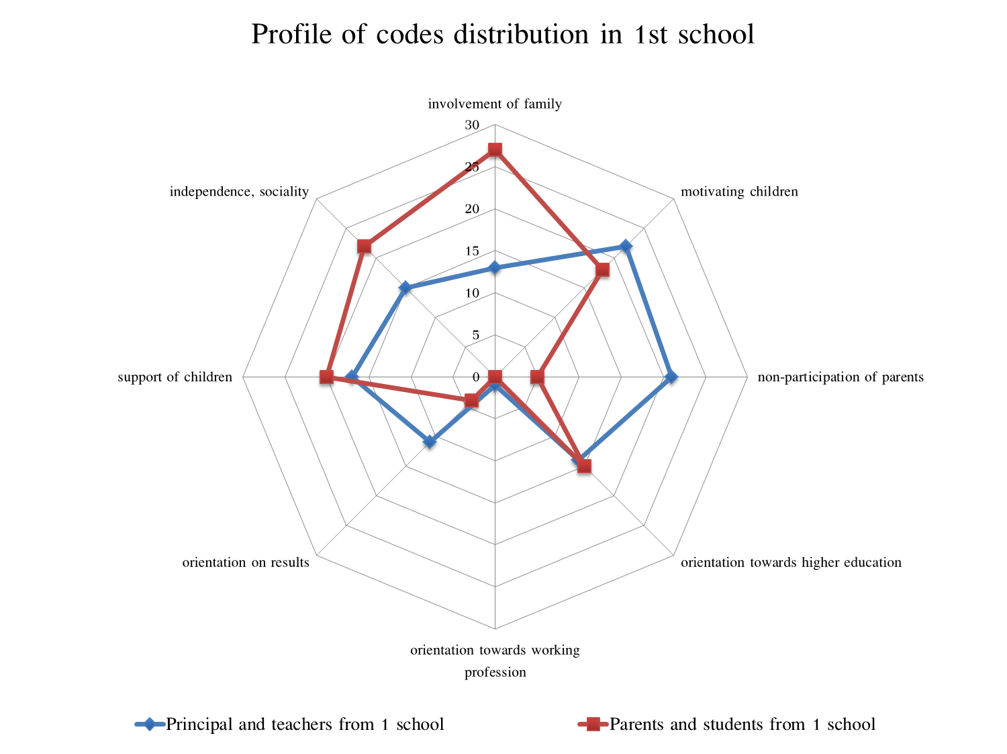
Institute of Education
Profile of codes distribution in 1st school

Slide 11
Institute of Education
Differentiation of educational strategies
Low-perfoming | High-motivated
Students:
Repeated explanation of the lesson material before or after the beginning of classes | Individual consultations on selected subject topics
Rewriting tests | Performing additional more complex tests
Basic level tasks in the classroom | Additional tasks in the classroom in addition to the tasks of the basic level
 | Preparation for participation in competitions
Parents:
Additional attention in the classrooms | Additional extracurricular activities
Principals and teachers:
Additional lessons for explaining the complex material | Preparation for contests and competitions
Additional lessons with students who missed lessons | Individual lessons on request
Additional classes in Russian for non-native students. | Studying in the profile class

Slide 12
Institute of Education
Specific tasks that teachers solve
 | Towards students | Towards parents
Main | Teaching the material at an accessible level. Adaptation of all students to the academic work. Overcoming the gap between regular students and students with educational problems. Support and motivate students with high abilities. | Informing about the child's achievements, problems in teaching and behavior Informing about educational opportunities, including additional.
Additional | Socialization and adaptation to the learning activity of socially neglected students (the role of a psychologist). Additional training and adaptation to the educational activity of students with a non-native Russian language (the role of a specialist in teaching the Russian language as a non-native language). Psychological help to students from disadvantaged families, compensation of deficits in parental support (the role of a psychologist). Assistance in choosing an educational trajectory and profession (role of tutor, career counselor). Bridging the gap of students with disabilities (role of the special teacher) | Involvement in the education of the child, conducting additional consultations, explanatory work. Consultation in the organization and regulation of home studies, the regime of the day. Control of parenting and family support in terms of food, leisure, education. Additional education for parents.

Slide 13
Institute of Education
Factors that promote and prevent burnout of teachers
Positive factors
Cohesion of the team.
Negative factors
Professional overload (direct duties).
Collaboration in the team.
Confidence in the administration, the absence of barriers between the administration and the teachers.
Participation in strategic and management decisions.
Pedagogical leadership of the administration.
Pedagogical freedom.
Emotional fatigue (additional duties).
Absence or deficiency of material compensation for extra labor.

Slide 14
Institute of Education
Conclusions
In resilient schools life forces teachers and principals to look for ways to improve their academic performance.
The main strategy of this schools is the strategy of higher expectations.
Schools compensate the deficit of families' support for student. They solve both educational problems, and tasks of socialization and mental health of students.
The results of the study are useful for school improvement programs and programs of professional development.

